Slide 1
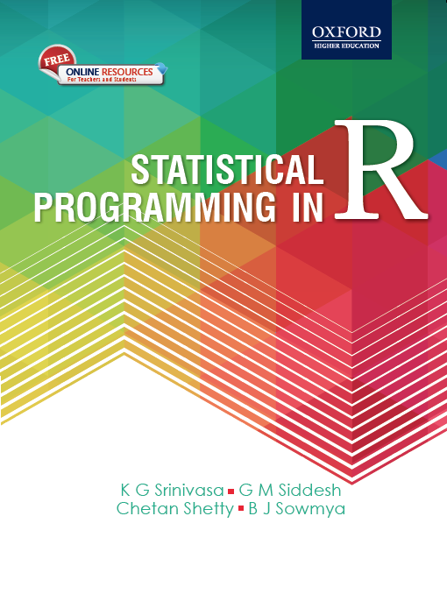

1
Statistical Programming in
R
Srinivasa, Siddesh, Shetty & Sowmya
© Oxford University Press 2017. All rights reserved.
1

Slide 2
Chapter 1Basics of R
Chapter will help the reader understand the following concepts:
R Environment setup
Installation of R and RStudio in Windows and Linux
Basics of programming in R
Data types, vectors, matrices, arrays, and classes
Subsetting and coercion

Slide 3
introduction
R is a language for statistical computing was initially developed by Ross Ihaka and Robert Gentleman at the University of Auckland in early 90s.
It is considered as an open source implementation of the S language.

Slide 4
Advantages
it is open source and hence free,
it has top-notch functionalities for effective graphical
representation of data,
it is easy to use.
Users can wrap their work in R scripts and this can be easily shared with colleagues

Slide 5
disadvantages.
R seems to be relatively easy to learn in the beginning, but it is hard to really master it.
As R is command-based, it becomes highly inconvenient for many of the statisticians and other non-computer science professionals to use

Slide 6
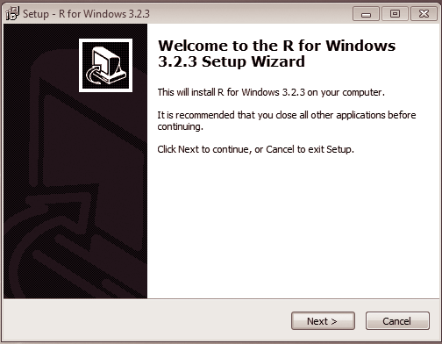
R-Environment setup
Installation of R(in windows)
R can be installed in Windows 7/8/10/Vista and supports both the 32-bit and 64-bit versions. Go to the CRAN website and select the latest installer R 3.3.3 for Windows and download the.exe file
After download, clicking on the setup file opens the dialog box
shown in Fig. 1.1.

Slide 7
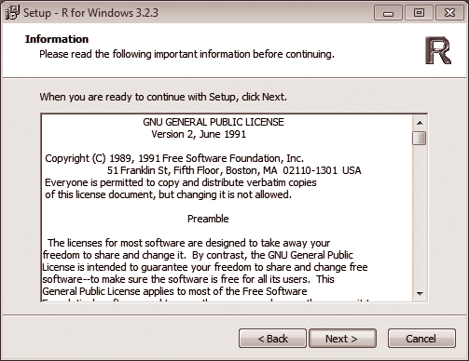
Click on the ‘Next’ button starts the installation process. This redirects you to the license window shown in Fig. 1.2; it is advisable to read the terms and conditions before selecting ‘Next’.
Fig. 1.2
R license agreement

Slide 8
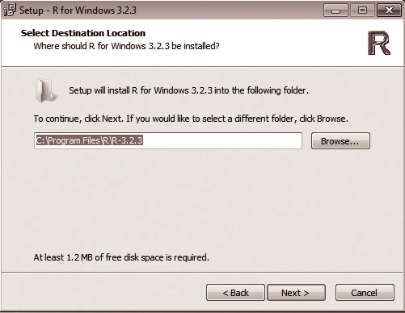
4. After selecting the next button from the previous step the installation folder path is
required (Fig. 1.3).
Select the desired folder for installation; it is advisable to select the C directory for smooth
running of the program.
• Fig. 1.3
Selecting the installation folder

Slide 9
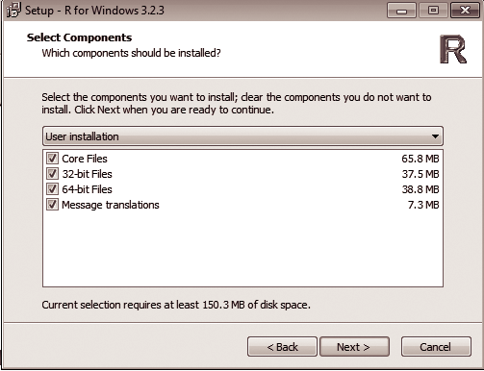
5. Next select the components for installation based on the requirements of your operating system (OS) to avoid unwanted use of disk space (Fig. 1.4).
Fig. 1.4
Selecting components for installation

Slide 10
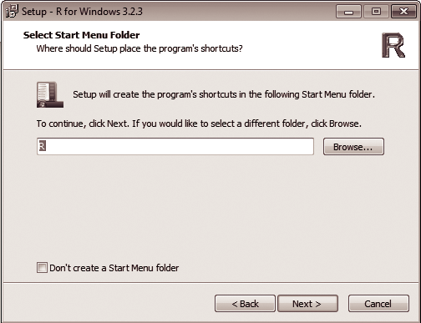
6. In the next dialog box (Fig. 1.5), we need to select the start menu folder. Here, it is better to go with the default option given by the installer.
Fig. 1.5
Selecting the Start menu folder

Slide 11
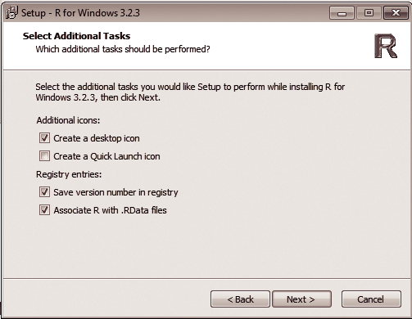
7. After setting up the Start menu folder, check the additional options for completing the setup as shown in Fig. 1.6.
Fig. 1.6
Additional options for setup

Slide 12
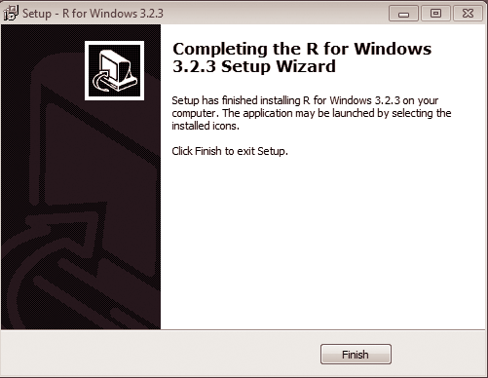
8. After clicking next from the previous step, the installation procedure ends and the window in Fig. 1.7 is displayed. Click Finish to exit from the installation window.
Fig. 1.7
End of installation

Slide 13
Instalation In Ubuntu
Go to the CRAN website or follow the link https://cran.r- project.org/bin/linux/ and it will redirect you to the index page. The index page contains four different parent directories—debain, Redhat, sesu, and ubuntu.
Add R to your repository by typing the following command:
sudo echo “dep http://cran.rstudio.com/bin/ubuntu trusty/” | sudo tee- a etc/apt/spurces.list.
Add R to Ubuntu keyring.
gpg –keyserver keyserver.ubuntu.com –recv-key E084DAB9
gpg -a –export E084DAB9 |sudo apt-key add –

Slide 14
3. Finally install R-Base.
sudo apt-get update
sudo apt-get install r-base r-base-dev apt-get update
$ yum install R
$ R

Slide 15
Install Rstudio
RStudio can be installed in any of the Windows platforms such as Windows 7/8/10/Vista and can be configured within a few minutes.
The basic requirement is R 2.11.1+ version.
The following are the steps involved to setup RStudio:
Download the latest version of RStudio just by clicking on the link provided here https://www.rstudio. com/products/rstudio/ download/

Slide 16
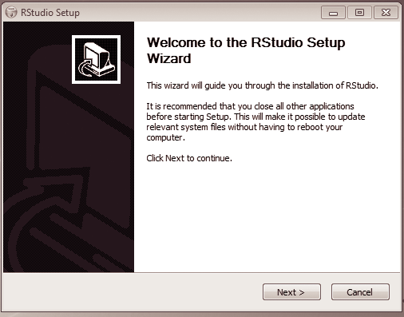
2. Download the.exe file and double click on it to initiate the installation as shown in Fig.
1.8
Fig. 1.8
RStudio Setup

Slide 17
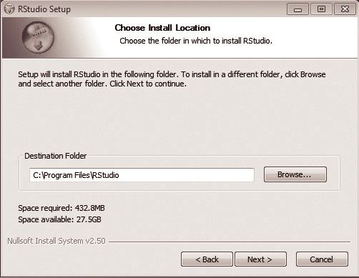
3. Click on the Next button and it redirects you to select the installation folder (Fig. 1.9).
Select ‘C:\’ as your installation directory since R and RStudio must be installed in the
same directory to avoid path issues for running R programs.
Fig. 1.9
Selecting the installation folder

Slide 18
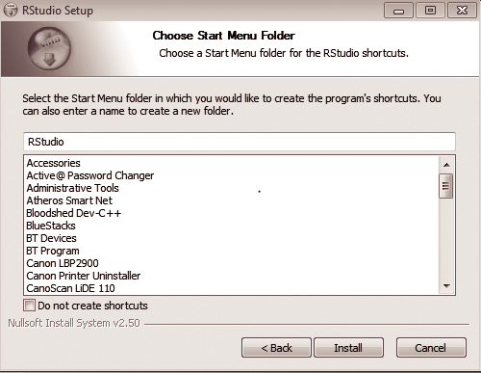
4. Click Next to continue and a dialog box asking you to select the Start menu folder
opens as shown in Fig. 1.10. Its is advisable to create your own folder to avoid any
possible confusion and click on Install button to install RStudio.
Fig. 1.10
Choosing the Start menu folder

Slide 19
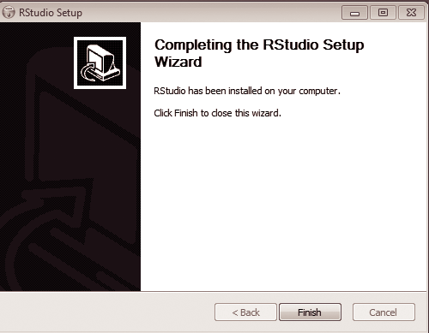
4. After completion of installation, the following window as shown in Fig. 1.11
appears. Click on ‘Finish’ to exit.
Fig. 1.11
Installation complete

Slide 20
Install RStudio in Linux
1. First install the core debain command for installation of the debain version of RStudio.
>sudo apt-get install gdebi-core
2. Using the wget command fetch the debain version of RStudio.
>wget https://download1.rstudio.org/rstudio-1.0.136-amd64.deb
3. After fetching RStudio, the following commands install RStudio with the standard
packages.
>sudo gdebi –n rstudio-1.0.136-amd64.deb
4. After installing RStudio, remove the installation file for saving disk space.
>rm rstudio-1.0.44-amd64.deb

Slide 21
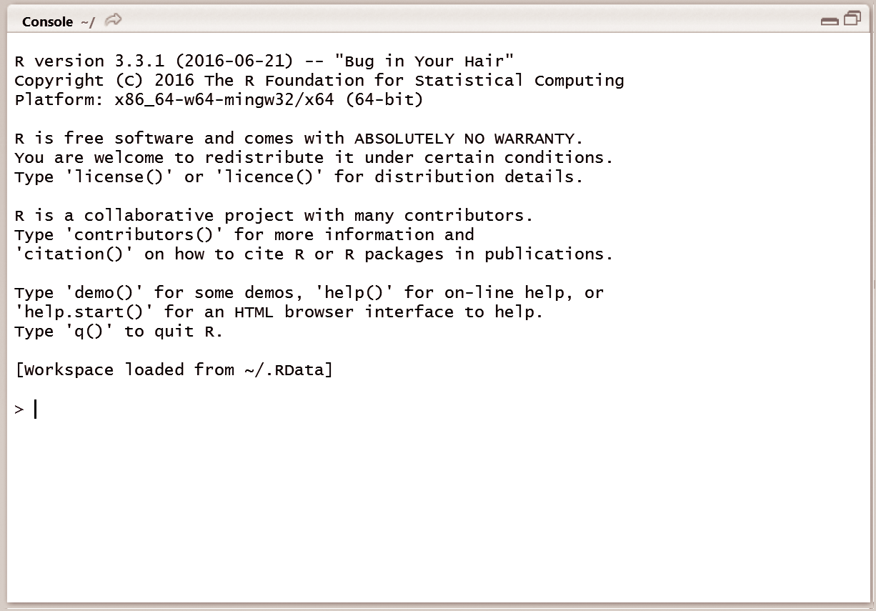
Programming with R
To begin with R, one needs to start working with R console where all the action takes place. Figure 1.12 gives a look and feel of the R console.
R console is an execution window where users can execute R commands.
Users need to type the required action on the command prompt and upon pressing the Enter key, R interprets the action typed by the user, executes the same, and gives the answer.
Fig. 1.12
R console

Slide 22
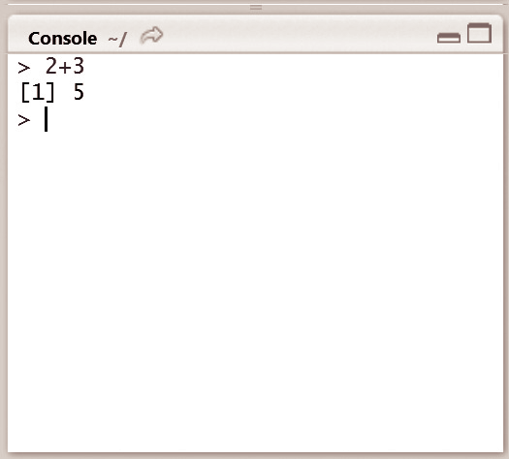
Some programs
Write the commands to perform basic arithmetic with R console.
To calculate the sum of two numbers, say 1 and 2, the programmer needs to type 1 + 2 in the command prompt of the console. (Fig. 1.13).
Fig. 1.13
Basic arithmetic with R

Slide 23
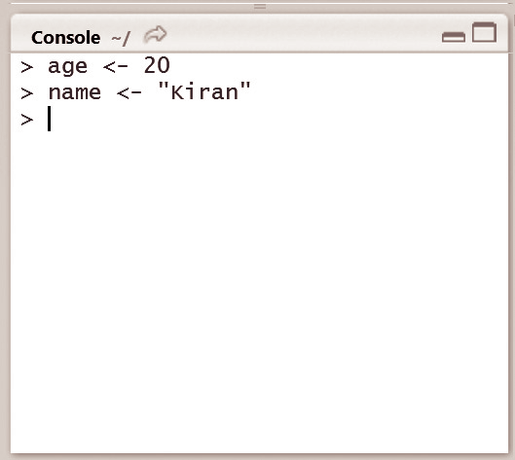
Declare variables in R console.
Later, to retrieve the values of the variables, the user just needs to enter the name of the variable in the command prompt and R returns the stored value of the variable.

Slide 24
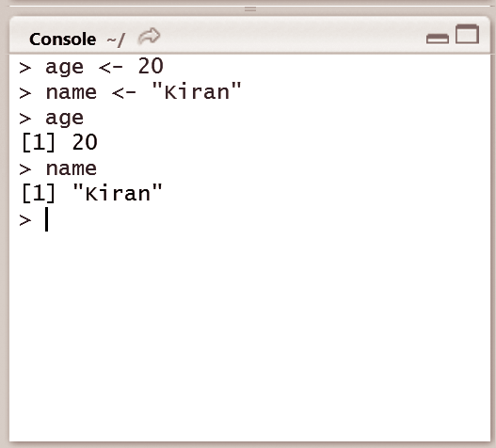
Write the commands for retrieving the value of the stored
variables in R console
As users assign values to variables in R console, these get accumulated in the R workspace. R workspace stores all the variables and their metadata information. Users can access the objects in the workspace using the ls() function. The usage of ls. ls lists all the stored variables that are created during the particular R session.

Slide 25
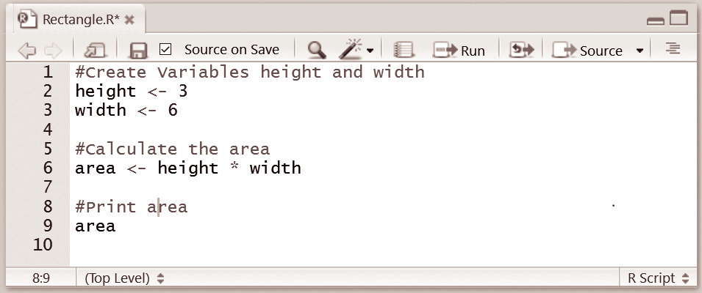
Write an R script with comments.
The comments in R start with the # symbol.If the user wants to run this script again, the lines starting with # do not affect R’s execution

Slide 26
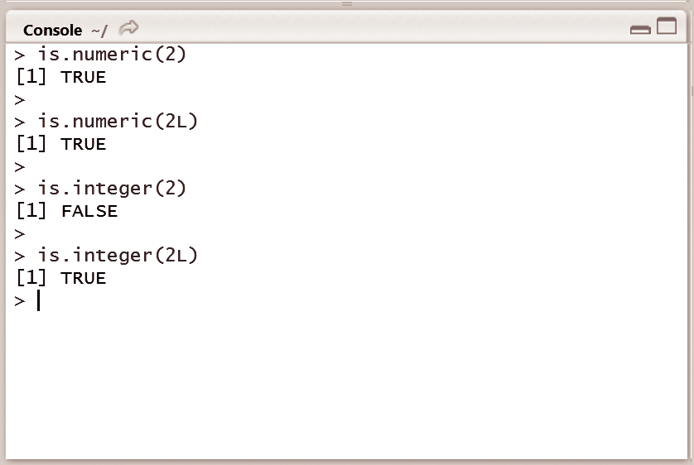
Enumerate the process to check whether a given input is numeric or integer using a function of R.
R provides a function for the programmers to check whether a given input is numeric or integer. This is known as the is-dot-function. Here, we use two functions—is.numeric() and is.integer()—as shown in Fig.
1.25, to check if a variable is a numeric or integer. In this particular case, it appears that both are numeric and the results also demonstrate the fact that all integer variables are numeric, but not all numeric variables are integers.

Slide 27
vectors
Vectors are the most basic R data objects. A vector is a sequence of data elements of the same data type.
There are six types of atomic vectors—logical, integer,
double, complex, character, and raw.
Programmers can create character vectors, numeric
vectors, logical vectors, and many more

Slide 28
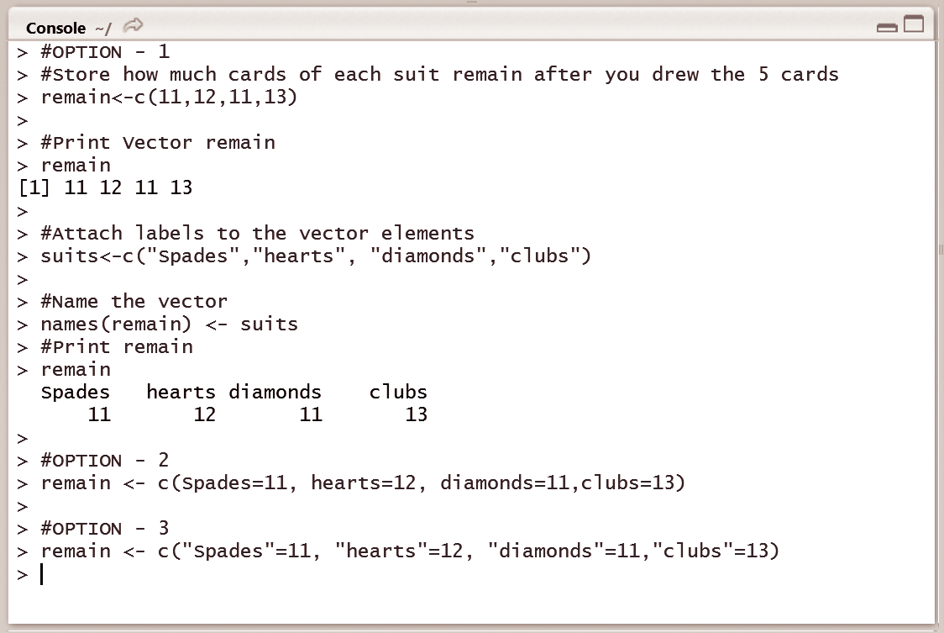
creating and naming vectors
A function c() is used to create a vector in R, which further allows users to combine values into a vector
Figure 1.33 shows the various options for
creating a new vector.

Slide 29
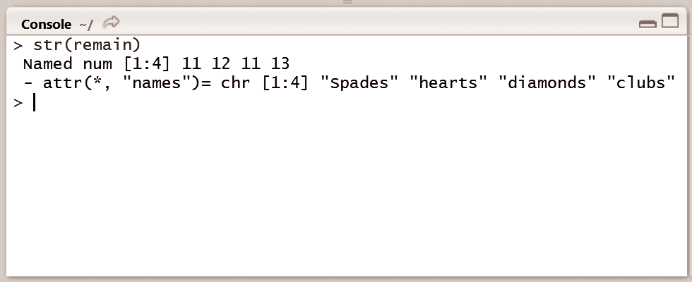
R allows programmers to name the data elements of the vector. R uses the names() function to name the vector elements.

Slide 30
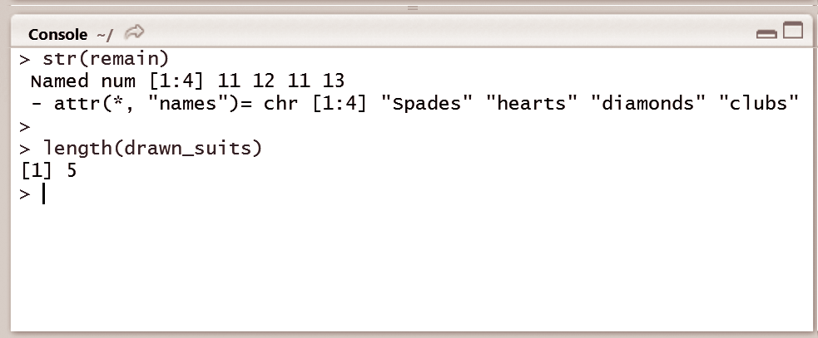
Vector Length
A single variable in R is actually a vector of length 1.
R provides a function utility named length() to determine the length of the vector.

Slide 31
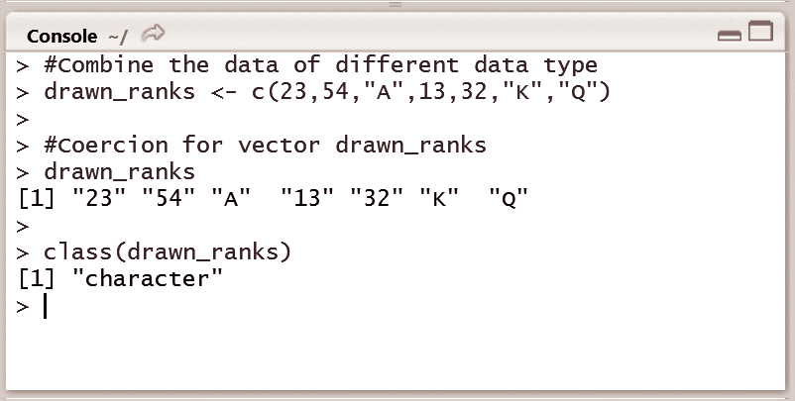
Coercion of Vector Elements
A vector in R can only hold elements of the same type, which means that users cannot have a vector that contains both logical and numeric data types.
If the user wants to build a mixed vector that contains both integers and characters, then automatically, R performs coercion to make

Slide 32
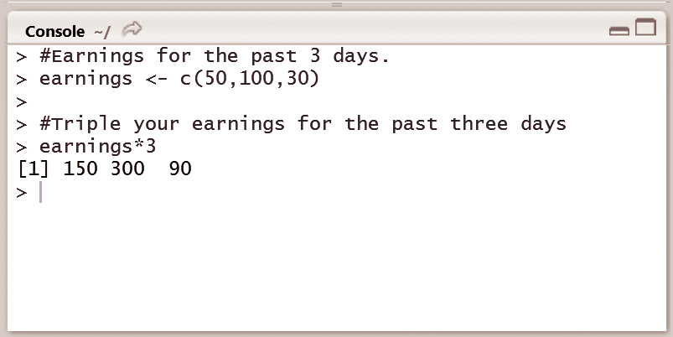
vector arithmetic
R allows programmers to perform arithmetic calculations with vectors and the operations are applied element by element
Fig show this simple vector arithmetic by multiplying the vector variable earnings by 3, where the vector earnings has been created with the three days of earnings in `.

Slide 33
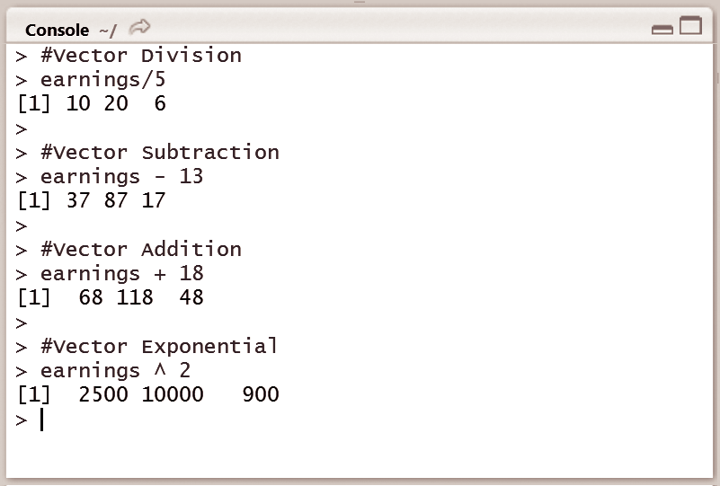
Illustrate summation, subtraction, multiplication, and division
operations on vectors using the earnings vector from
Figure illustrates the division of the earnings vector by 5, subtracting 13 from the earnings vector elements, adding 18 to the vector elements, and finding the exponential of 2 of the elements of earnings

Slide 34
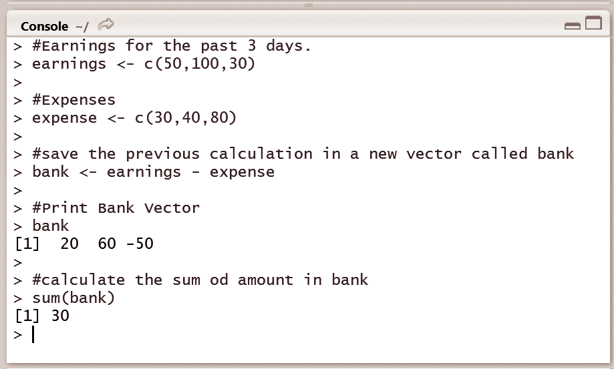
Enumerate multiplication and division operations between matrices and vectors in R
console.
the multiplication of two vectors can result in a single scalar
or a matrix.
Figure shows users how to check their bank accounts’ status
after these three days of earnings in the city of Bangalore.

Slide 35
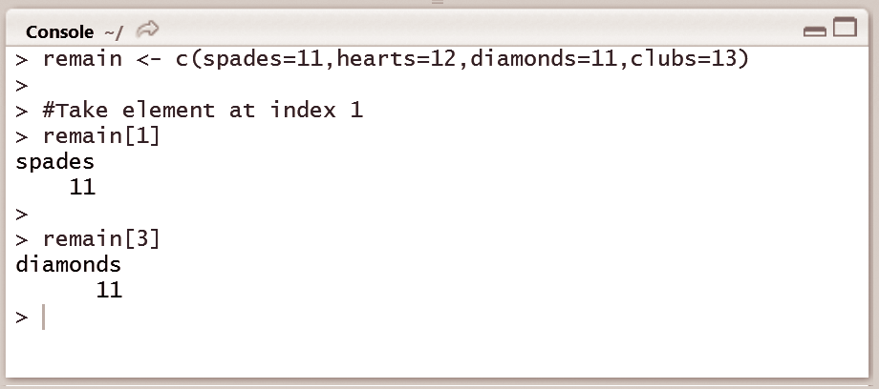
vector Subsetting
Vector subsetting is used to break vectors into selected parts and derive a new vector known as a subset of the original vector.
Figure illustrates the usage of vector subsetting by considering users want to select the first element from the vector, corresponding to the number of spades that are left. Users can use square brackets for this.
Programmers write remain [1], where the number 1 inside the square brackets indicates that users want to get the first element from the remain vector.

Slide 36
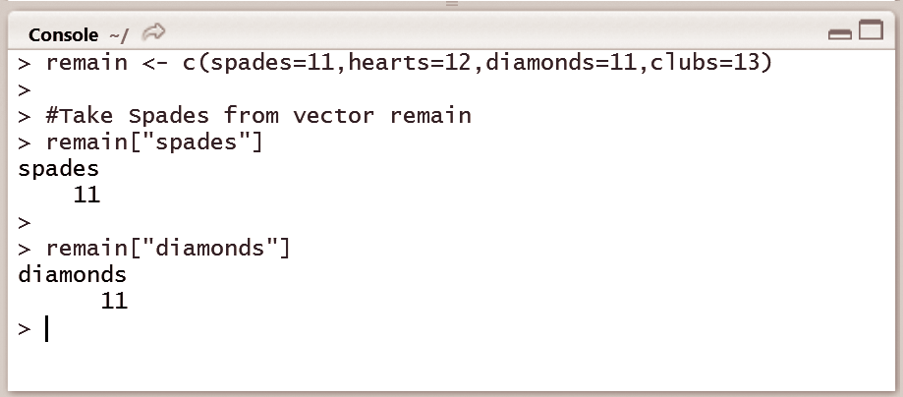
If users are dealing with named vectors, they can also use the names to perform the selection. Instead of using the index 1 to select the first element, users can use the name spades.

Slide 37
Matrices
Matrices are the R objects in which the elements of the same atomic type are arranged in a two-dimensional rectangular layout
The basic syntax for creating a matrix in R is
matrix(data, nrow, ncol, byrow, dimnames)
The following are the attributes used in matrix
data is the input vector which becomes the data elements of the matrix.
nrow is the number of rows to be created.
ncol is the number of columns to be created.
byrow is a logical clue. If TRUE then the input vector elements are arranged by row.
dimnames are the names assigned to the rows and columns.

Slide 38
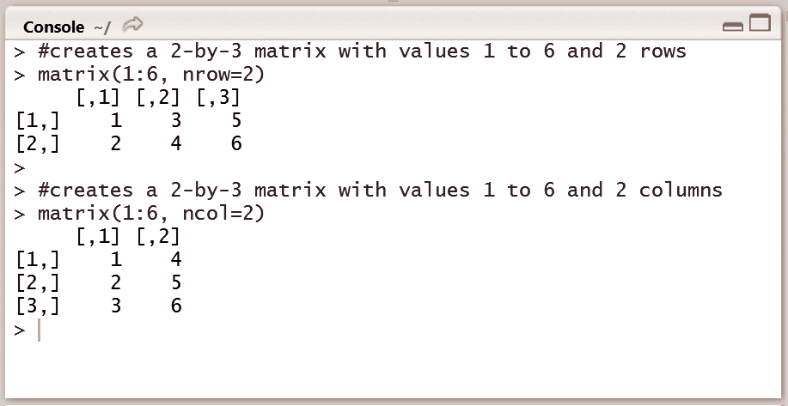
creating matrices
As with vectors, a matrix can contain only one atomic vector type.
To build a matrix, users use the matrix function. Most importantly, it needs a vector containing the values that users want to place in the matrix, and at least one matrix dimension. Users can choose to specify the number of rows or columns.
Figure shows the creation of a 2-by-3 matrix containing the values 1 to 6, by specifying the vector and setting the nrow argument to 2.

Slide 39
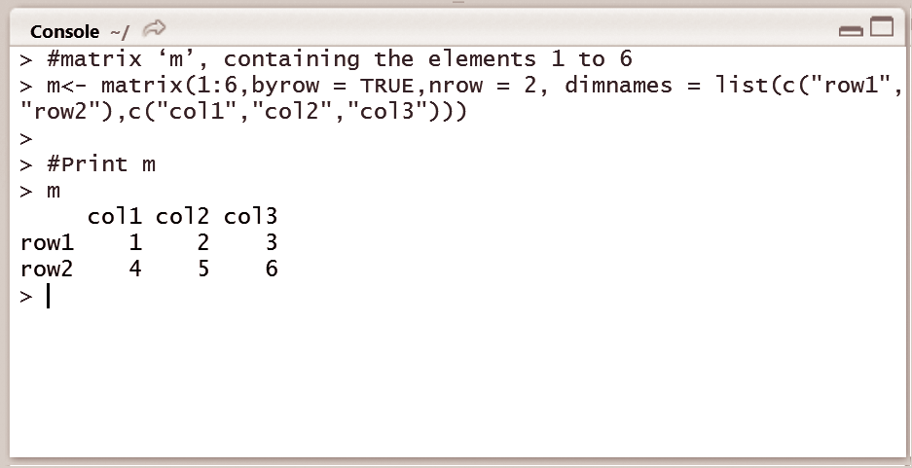
naming matrices
as with vectors, there are also one-liner ways of naming matrices while we are creating it. We can use the dimnames argument of the matrix function for this. We need to specify a list that has a vector of row names as the first element and a vector of column names as the second element as shown in Fig

Slide 40
Matrix Subsetting
to select a single element or entire parts of a matrix to continue the analysis with. Again, we can use square brackets for this
If we want to select a single element from this matrix, we will have to specify both the row and the column of the element of interest.
If we want to select the number 15, located at the first row and the third column we type m[1,3].

Slide 41
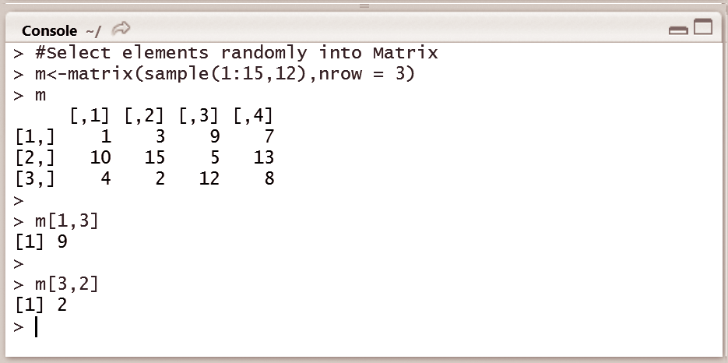
As is evident, the first index refers to the row and the second one refers to
the column.
Likewise, to select the number 1, at row 3 and column 2, we write m[3,2]. Notice that the results are single values, that is, vectors of length 1.
•Now, what if we want to select an entire row or column from this matrix? We can do this by missing either the row or column index within the square brackets.
Instead of writing [3, 2] to select the element at row 3 and column 2, if we write
[3,], this would select all the elements that are in row 3

Slide 42
Arrays
An array is a collection of similar data of the same type, for
example, numeric.
R uses a vector to create an array only if there is a dimension vector with dim attributes.
The array() function is used to create an array
The basic syntax for creating an array in R is
array(data, dim, dimname) where,
data is the input values to the vector
dim is used to create the dimension
dimname is used to assign a name to dim

Slide 43
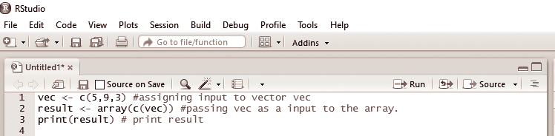
Figure shows a program creating an array of 3 elements.
First, values are assigned to the object vec.
Then an array is created with vec passed as an input.
Finally the array is displayed

Slide 44
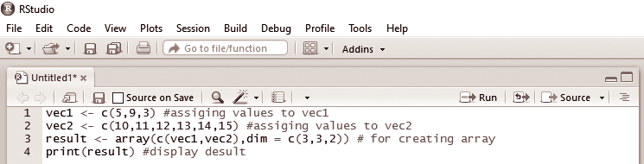
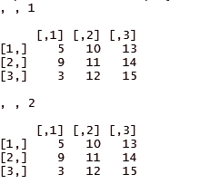
Write a program to create an array of 3×3 matrixes with 3 rows
and 3 columns.
shows the code to create an array of matrices. First values are assigned to objects vec1 and vec2. Then the array is created and displayed in matrix form.

Slide 45
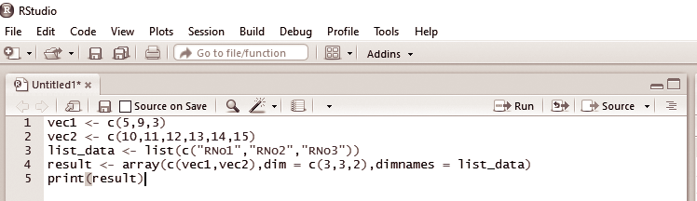
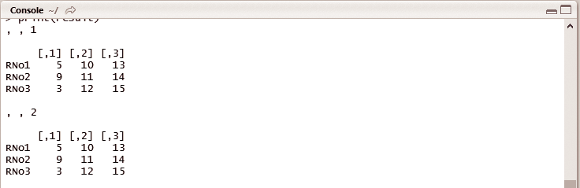
Write a program to assign dimension name to an array of 3×3
matrixes.
. First, values are assigned to objects vec1 and vec2. Then an array is created and names RNo1, RNo2, and RNo3 are assigned to the array matrix. Finally the dimension names are displayed in a matrix form.

Slide 46
Class
in R language is considered as an object and every object is associated with a class.
To create a class in R using the class keyword.
S3 class
S3 classes are used to implement an object-oriented (OO)
concept known as generic function OO.
In S3 class, we use the concept of list property, where a list is created and a list class is set and returned.

Slide 47
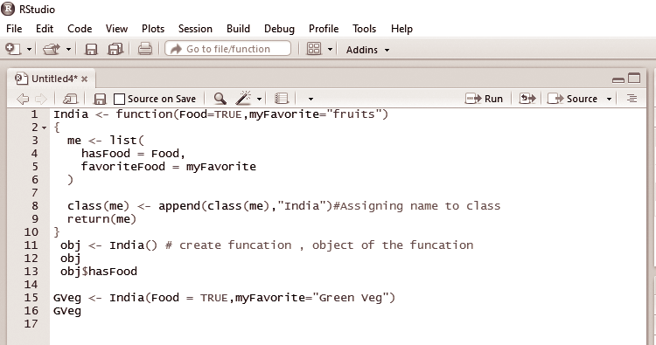
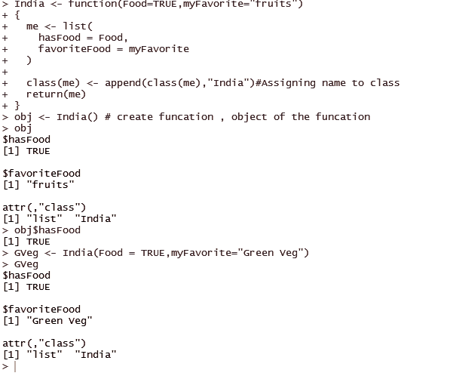
Write a program to create a class, object, and function.

Slide 48
Chapter 2:
Factors and Data Frames
This chapter will help the reader understand the following concepts:
Factor levels, summary, ordered factors
Data frame creation, subsetting, sorting

Slide 49
Introduction to factors
There are three kinds of variables in R programming:
Categorical
ordinal
interval

Slide 50
categorical variable
A categorical variable is one that has two or more categories, but there is no intrinsic ordering to the categories.
For example, gender is one categorical variable with male and female being the possible values.

Slide 51
ordinal variable
An ordinal variable is a categorical variable, but there is an intrinsic order present for the values it can take.
The economic status may be low, medium, or high and
grades in college are S, A, B, C, D, E, F.

Slide 52
interval variable
These variables are defined by specific ranges such as
$10–$15, age in the range of 20–25, height ranging from 5
feet 5 inches to 5 feet 9 inches

Slide 53
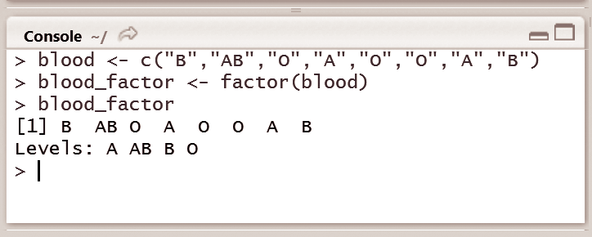
factor
A factor is a statistical data type that stores categorical variables, which is used in statistical modelling.
Factors are stored as a vector of integer values with a set of character values.
To convert this vector to a factor, the factor( ) function
can be used as shown in Fig.

Slide 54
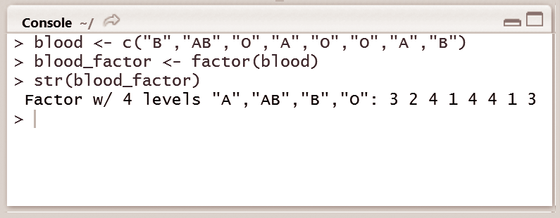
R performs two functions when the factor() function is called on a
character vector:
First, it scans through the vector to check the availability of different categories, R performs a check for categories of blood groups among “A”, “AB”, “B”, and “O”.
Further it sorts the levels alphabetically as can be observed from

Slide 55
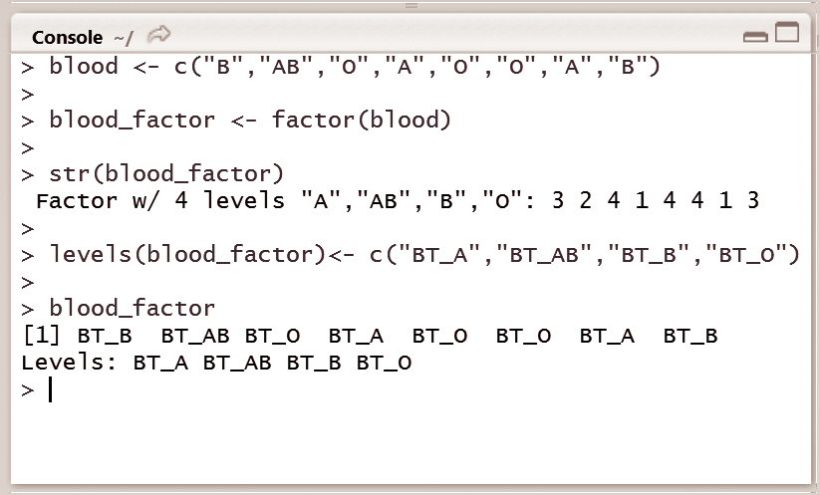
Factor Levels
Factors are integer vectors where each integer corresponds to a category or a level.
R allows programmers to perform this task using the function levels( ).
In case a different ordering of the levels is required, the argument can be specified in the factor function.

Slide 56
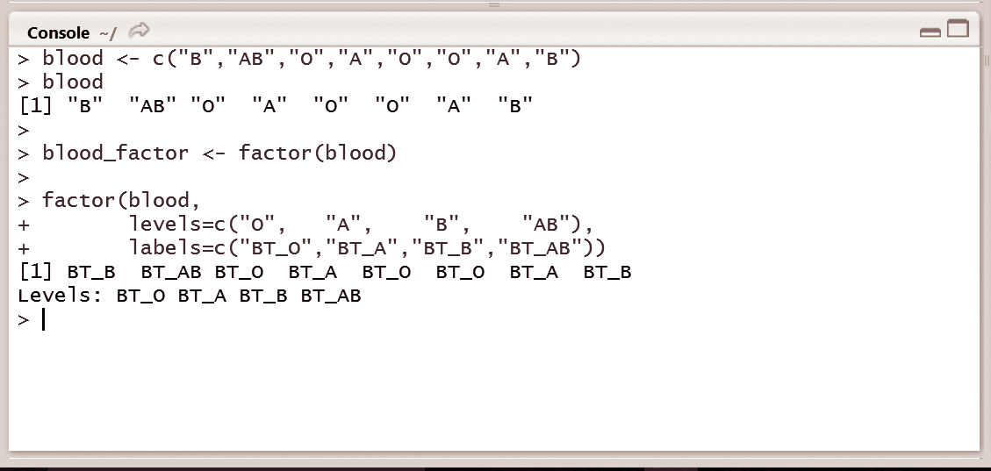
To change the order of the levels, it is possible to manually specify the level names, instead of letting R choose them.
To display the blood types as ‘BT_A’, ‘BT_AB’, ‘BT_B’, and ‘BT_O’, we can use the levels() function.
We can specify the category names or levels by using the labels argument in the factor() function.

Slide 57
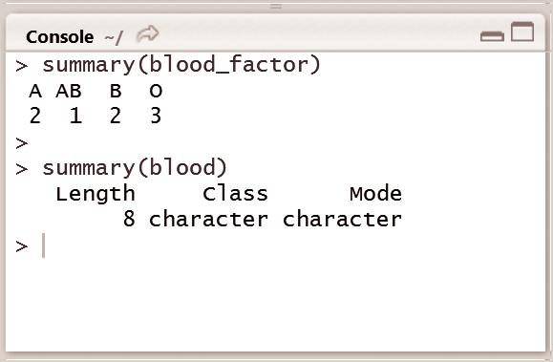
summarizing a Factor
Summary is a generic function used to produce summaries of the
results.
For instance, in Fig, summary of the blood_factor object shows the 4 categories of blood groups A, AB, B, and O and the summary of the object blood shows us the number of elements in the vector (which is 8), the class, and the mode of that vector.

Slide 58
ordered Factors
There are examples where a natural ordering exists; sometimes programmers have to deal with factors that do have a natural ordering among their categories.
In the domain of categorical variables, there exists a difference between nominal categorical variables and ordinal categorical variables.
A nominal categorical variable, as mentioned earlier, has no implied order.

Slide 59
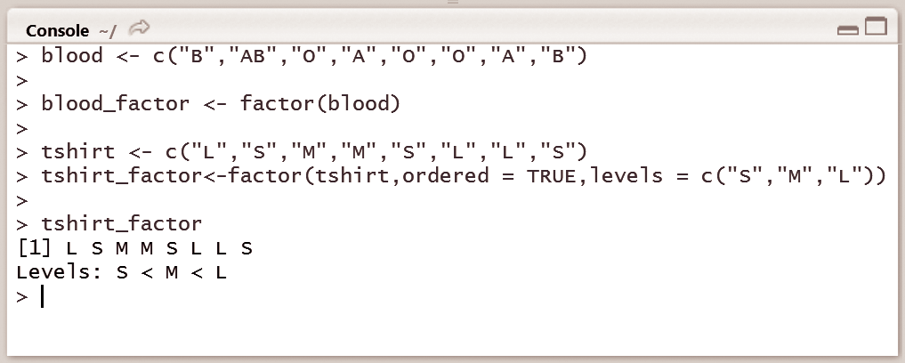
Write a command in R console to create a tshirt_factor, which is ordered with levels ‘S’, ‘M’, and ‘L’. Is it possible to identify from the examples discussed earlier, if blood type ‘O’ is greater or less than blood type ‘A’?
Fig. we can see that it is difficult to identify whether blood type
“O” is greater or less than blood type “A”.

Slide 60
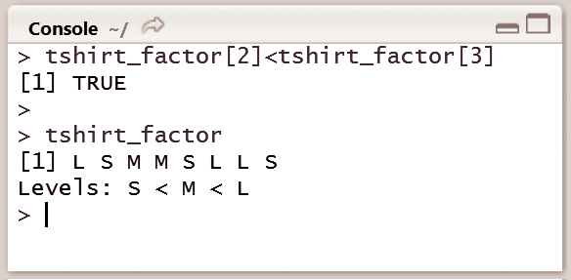
comparing ordered Factors
It is possible to compare ordered factors in R.
This is explained in Fig it is specified that L is indeed greater than M. R provides a way to impose this kind of order on a factor, thus making it an ordered factor. This is achieve by the factor() function, where the argument ordered is set to TRUE and the levels are specified in ascending order.

Slide 61
Data frame
Data sets typically comprise observations, or instances, that have some variables associated with them.
Data frame is a fundamental data structure to store data
sets
For example, consider a data set of five people,
A matrix cannot be used to store such information in R, as name would be a character and age would be numeric and these will not fit in a matrix.

Slide 62
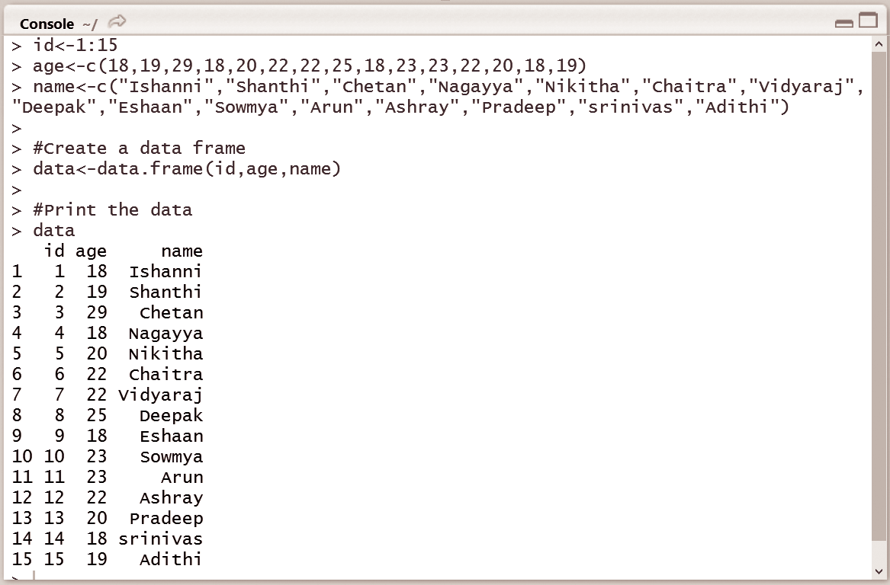
creating a Data Frame
A data frame is created using the function data.frame() by using a variable data.
The parameters are the vectors created earlier, which are passed to
the data frame as follows:
data.frame(ID, age, name)
The contents of the data frame can be displayed by printing the contents of the variable data, which looks like a spreadsheet.

Slide 63
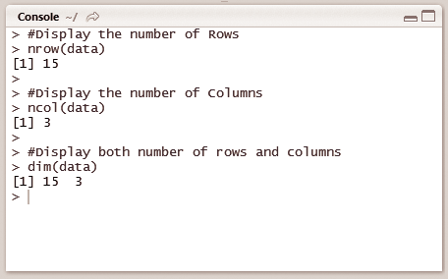
Compute number of rows and columns
The number of rows and columns in a data frame can
be computed using the functions nrow() and ncol( )
The number of rows and columns of a data frame can be visualized in an environment
window

Slide 64
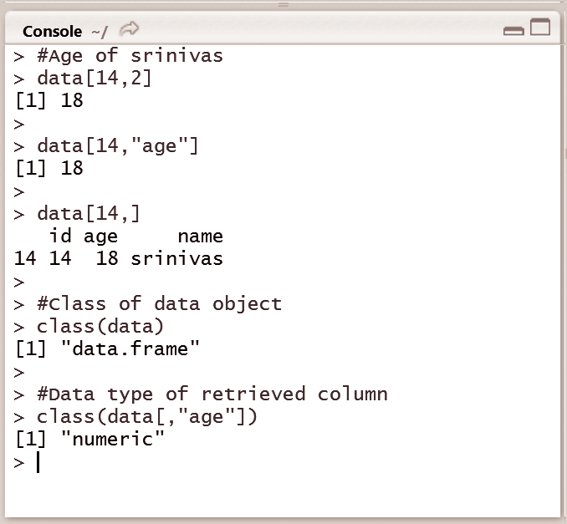
sub setting of Data Frames
The data frame combines the features of matrices and lists.
To subset a data frame from both matrices and lists, the following syntax can be used;
Single brackets ‘[‘ are used for sub setting matrices
double brackets ‘[[‘
dollar sign ‘$’ are used to select list elements.
Figure illustrates the process of subsetting a data frame by considering the previous data set in Fig. 2.9 containing 15 employee records

Slide 65
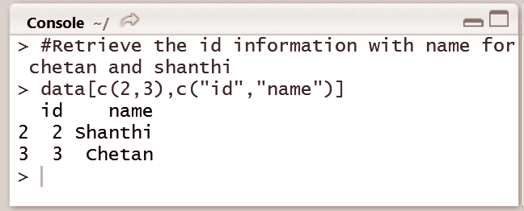
Write the command in R console to retrieve the name and id information from the 2nd and 3rd rows.
Figure illustrates retrieving data from rows 2 and 3 by selecting
the name and id information of Chetan and Shanthi.

Slide 66
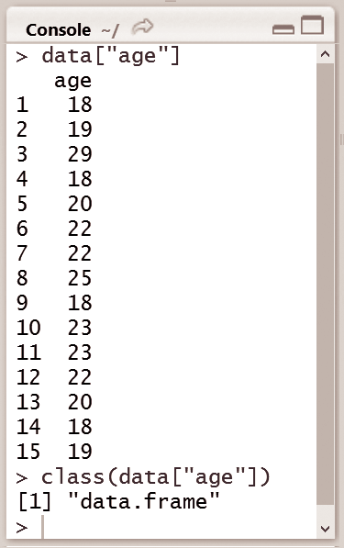
Write the command in R console to create a new data frame
containing the ‘age’ parameter from the existing data frame.
Check if the result is a data frame or not.
Single brackets can also be used to subset lists; this generates a new list containing only the specified elements. The result is still a data frame, which is a list, but containing only the “age” element as shown in Fig.

Slide 67
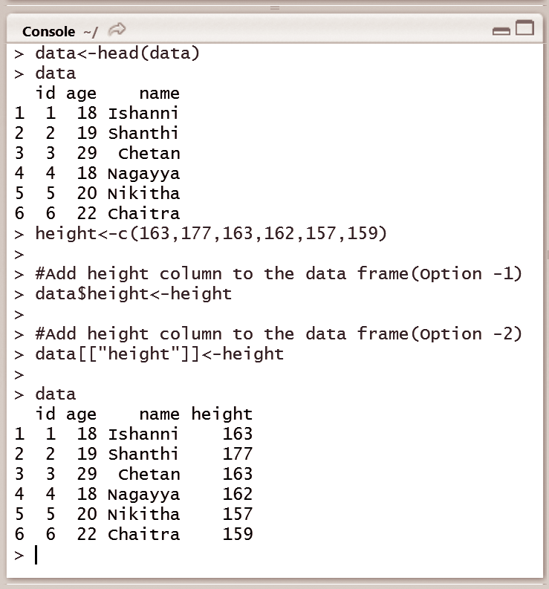
extending Data Frames
To add a column, new variable, new row, or new observation to the existing data frame, the dollar sign or the double square brackets can be used. In Fig, a vector named ‘height’ is created and is added to data using $ and [ ].

Slide 68


The cbind() function can also be used to build and extend matrices. It
works similar to the data frames shown in Fig.
If cbind() works, than rbind() will work fine as well. Indeed, rbind() is used to add new rows to observations
To add the information of another employee named Karan to the data frame, simply creating a vector with the id, name, age, and height, won’t work, because a vector can’t contain elements of different types. A new data frame needs to be created containing only a single observation, and that needs to be added to the existing data frame using rbind(). The usage of cbind() and rbind() are shown in Fig

Slide 69
sorting Data Frames
To sort the data frame by age, such that the youngest person is on top, and the oldest at the bottom.
the sort() function can be used. This function sorts a vector into ascending or descending order.

Slide 70


Write the command in R console to display the values of age of data in ascending order using the sort() function.
Fig. it can be observed that if the sorting is done based on the age column, then an ordered version of the age column is returned.
To change the ordering of the rows in the data frame, order() function can
be used instead of the sort() function.

Slide 71

To sort in descending order, the decreasing argument is set to TRUE

